Slide 1
Predicting LCA outcomes for H1B applications
By Salil M Harsulkar (samihars@iu.edu)s
A project for Applied Machine learning (sp18 – 33910)
Indiana university school of informatics

Slide 2
Project Introduction and EDA
Project background and Data Introduction - H1B is a non-immigrant work visa issues by USCIS to eligible foreign workers that poses specialized skills not easily available in US market. Labor Condition Application (LCA) is the prerequisite for applying for H1B which basically forces US employers to prove labor shortage in US market.
Data Introduction - The data is openly available on OFLC website. I am using the data for LCA applications filed between Sept 2016 - Sept 2017 as training data and Oct 2017 - Dec 2017 as testing dataset. Both datasets have 51 predictor fields and 1 target field. The training and test data is highly biased towards one particular outcome so I converted the 4 class target field to a 2 class field to reduce the bias without any impact to the problem outcome.
EDA and Preprocessing pipeline –
EDA involved exploring data set and identifying patterns, outliers and redundancy in predictor variables. Detailed results available in the report.
Data Preprocessing Pipeline flow
Feature Engineering
Fill Missing Values
Data Filtering
Feature Selection
Numerical Encoding
Categorical Encoding
Scaling

Slide 3
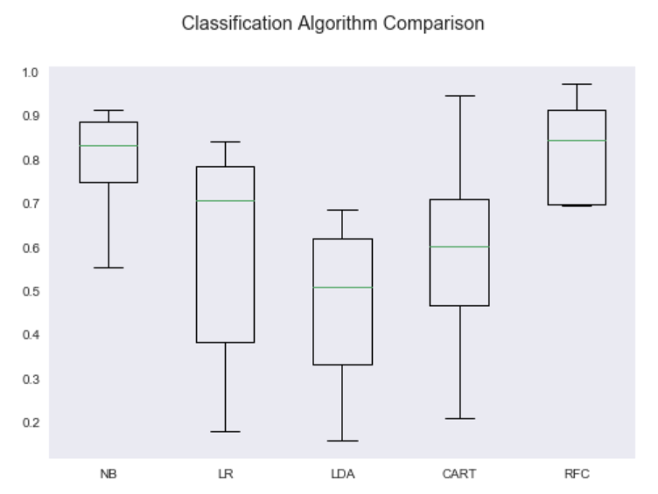
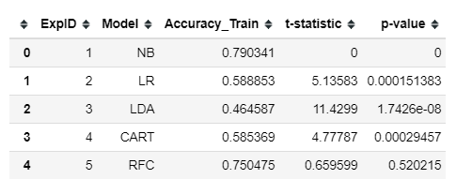
Select Model and Performance Metrics
Models Evaluated -
Supervised Binary Classification problem
Evaluated 5 Classifier models – Logistic Regression, Gaussian Naïve Bayes, LDA,
Random Forest Classifier, CART
Evaluated selected models using entire training data set by K-fold Cross validation.
Statistical significance test performed
Gaussian Naïve Bayes model selected
Performance Metrics –
Training data highly biased towards Target class = ‘CERTIFIED’ so did not select Accuracy Score.
Biased training dataset inherently induced model overfitting
Success criteria = Good classification performance for Minority Class
3 performance metrics chosen –
F1 score (Recall more important than Precision),
Confusion Matrix
Classification Report

Slide 4
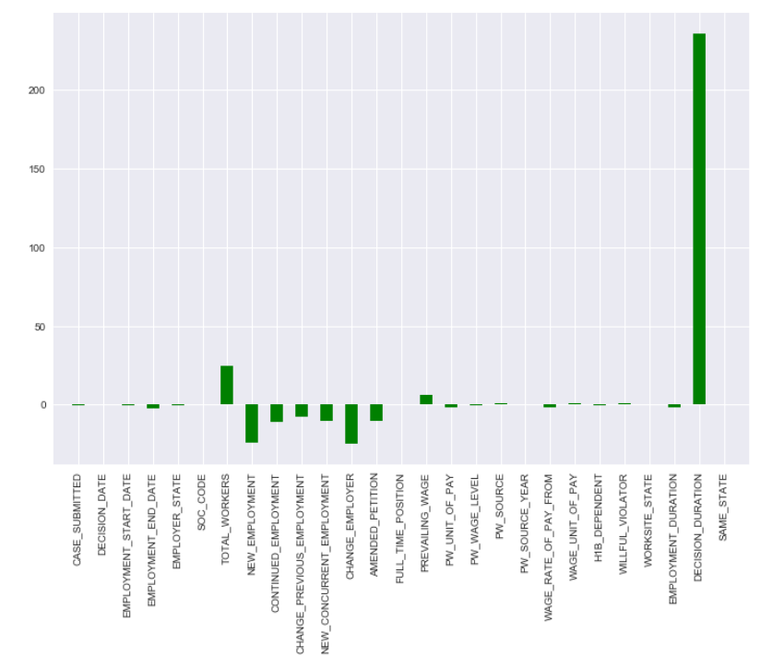
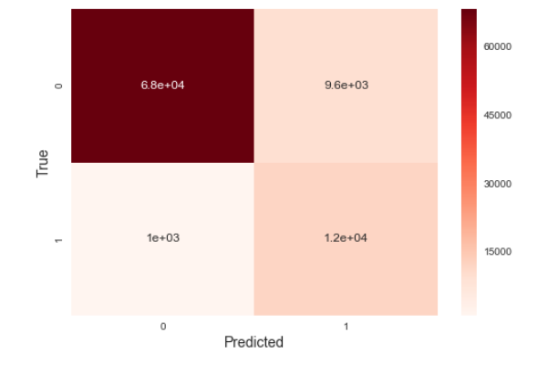
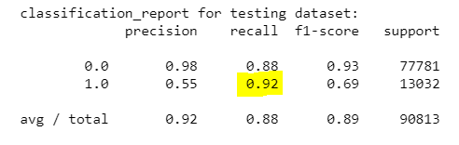
Feature importance and Model Validation
Feature Importance -
High dimensional training space so feature selection algorithm implemented
Logistic Regression with L1 regularization used as feature selector
Feature space reduced from 27 to 21 features.
Model Validation –
Predicted Target class values for Test data using Pipeline containing Feature selector and classifier steps.
F1 score – Class 0 = 0.93, Class 1 = 0.7
Classification report -

Slide 5
Observations, Challenges and Conclusion
Observations -
Our goal was to have a good recall for the minority class which was achieved. The Accuracy of the model is at a decent 88% for test dataset.
Confusion Matrix from the perspective of the minority class – True positives ~ 12k, False positives ~ 9.6k, True negatives ~ 68k, False negatives ~ 1k
Precision and Recall for majority class is pretty high and within acceptable performance threshold. For the minority class of 1, the recall is good but the precision is pretty low at 55%.
Conclusion -
This has been an interesting project for applying all the machine learning knowledge that I learned over this course. Based on the recall, precision and f1-score values of the classifier on test dataset, it can be said that the selected classifier model is reliable and can successfully classify real life dataset with good precision and accuracy.
Future Work –
This project can be enhanced further by evaluating the performance of more advanced classifiers like SVM, MLP and Random Forest ensemble. Further work should also be done on improving the precision score for the minority class which is currently at 55%. The model is underfit for Class 0 and training an ensemble classifier may help in improving the precision.

Slide 6
Thank You!
Please feel free to contact me at samihars@iu.edu for questions/comments.

